Slide 1
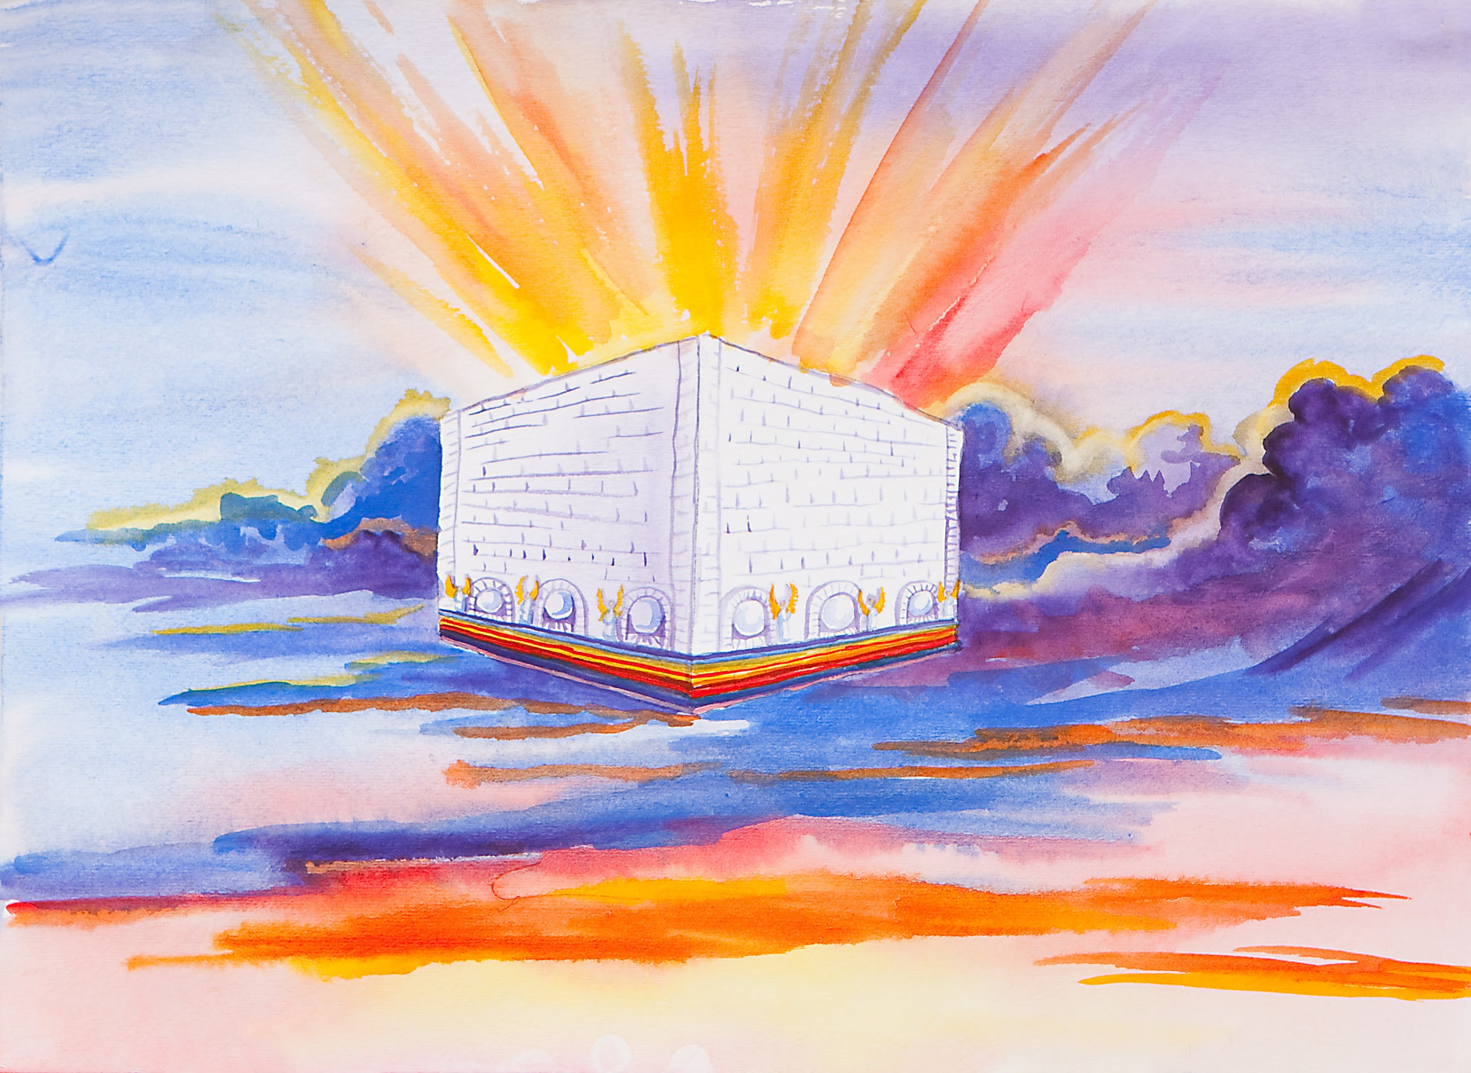
The latter glory of this house shall be greater than the former, says the Lord of hosts. And in this place I will give peace, declares the Lord of hosts. Haggai 2:9
這殿後來的榮耀必大過先前的榮耀；在這地方我必賜平安。
這是萬軍之耶和華說的。 哈該書 2:9

Slide 2
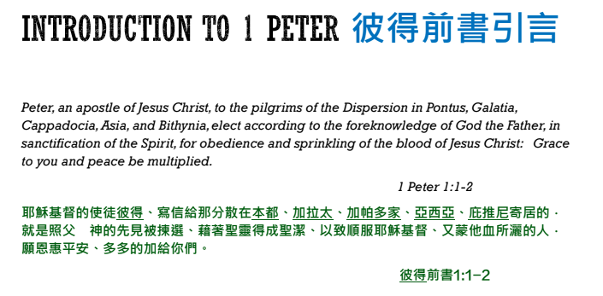
Notes:
Review who wrote the letter, to whom it’s written

Slide 3
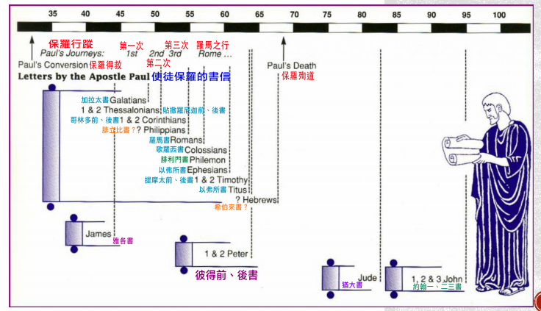
Notes:
The timing of the letter and persecutations

Slide 4
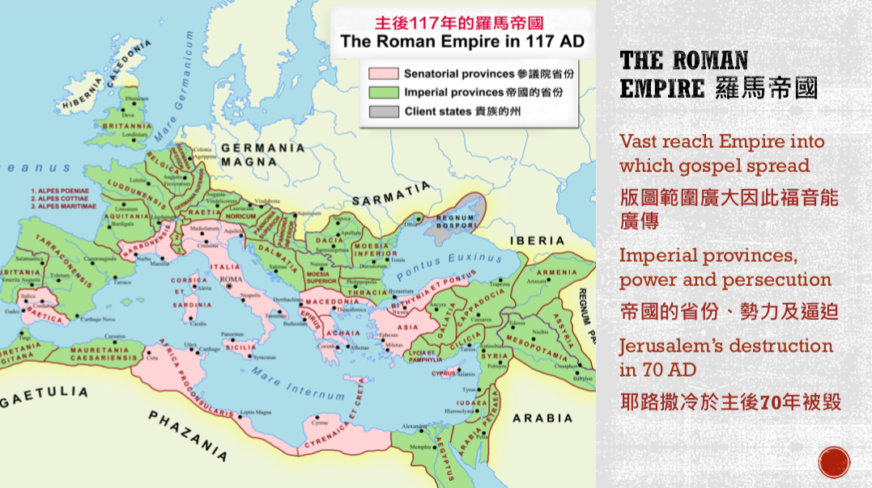

Slide 5
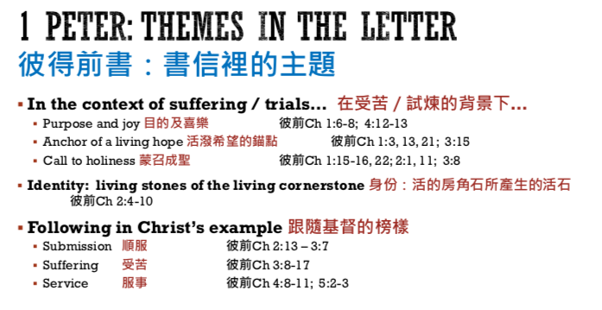
Notes:
Themes in I Peter

Slide 6
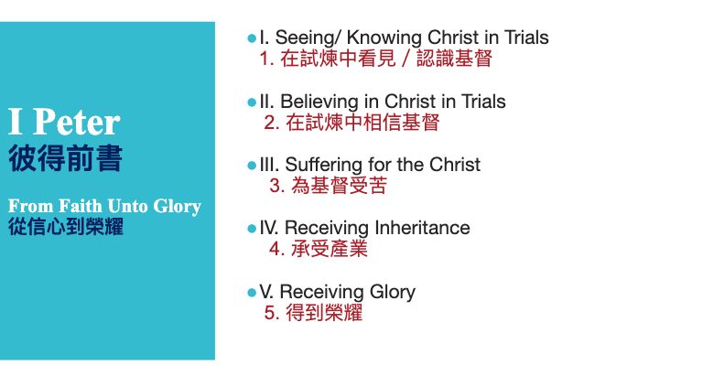
Notes:
Theme in parallel to sonship, faith through trials

Slide 7
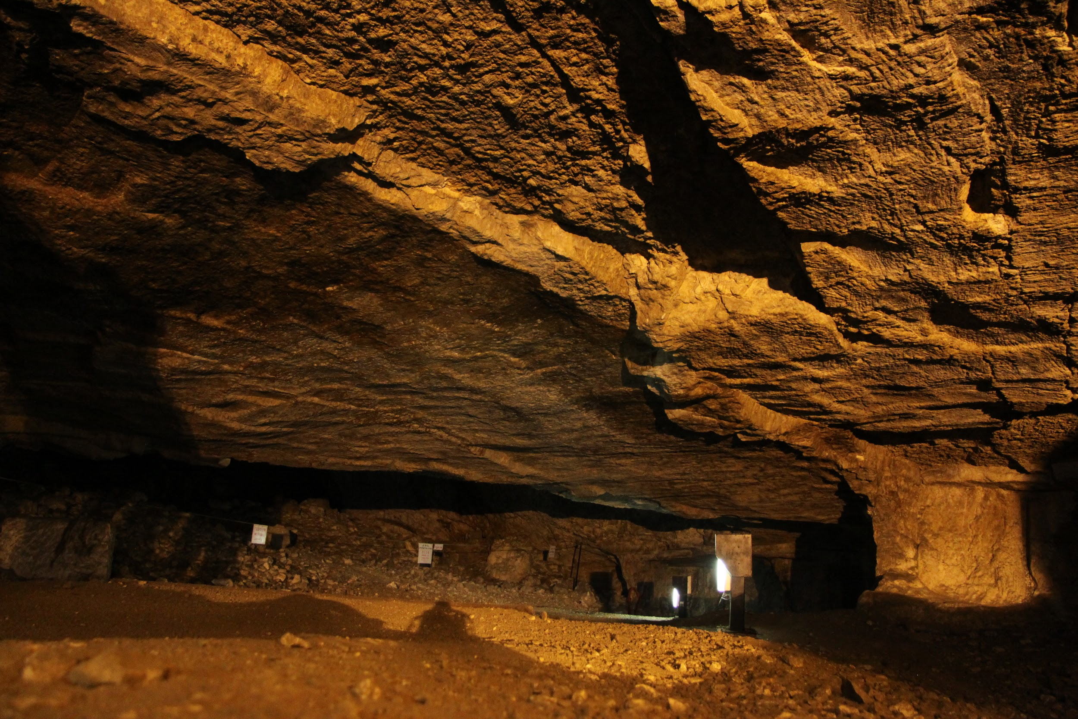
Notes:
Guess what is this?

Slide 8
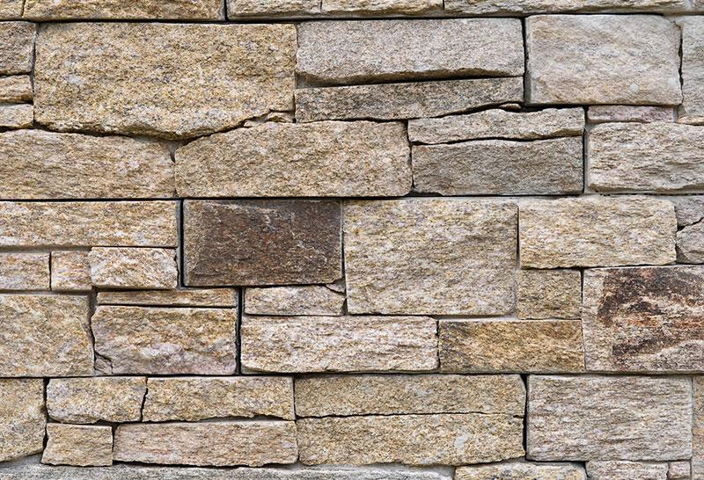
Notes:
This is easier - can someone explain this?

Slide 9
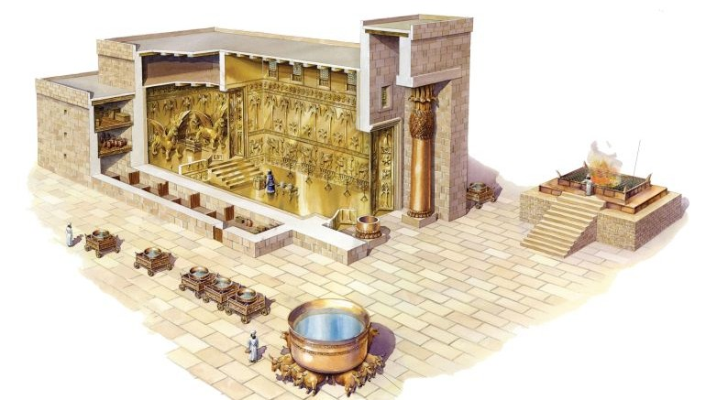
Notes:
This is the easist - what is this?

Slide 10
As you come to him, a living stone rejected by men but in the sight of God chosen and precious, you yourselves like living stones are being built up as a spiritual house, to be a holy priesthood, to offer spiritual sacrifices acceptable to God through Jesus Christ.
For it stands in Scripture:
“Behold, I am laying in Zion a stone,
a cornerstone chosen and precious,
and whoever believes in him will not be put to shame.” 1 Peter 2:4-6
主乃活石，固然是被人所棄的，卻是被神所揀選、所寶貴的。你們來到主面前，也就像活石，被建造成為靈宮，作聖潔的祭司，藉著耶穌基督奉獻神所悅納的靈祭。
因為經上說：看哪，我把所揀選、所寶貴的房角石安放在錫安；信靠他的人必不至於羞愧。 彼得前書 2:4-6
Notes:
Reading through these, these are the key verses (these 3 slides)

Slide 11
So the honor is for you who believe, but for those who do not believe,
“The stone that the builders rejected has become the cornerstone,”
And “A stone of stumbling, and a rock of offense.” They stumble because they disobey the word, as they were destined to do.But you are a chosen race, a royal priesthood, a holy nation, a people for his own possession, that you may proclaim the excellencies of him who called you out of darkness into his marvelous light. Once you were not a people, but now you are God's people; once you had not received mercy, but now you have received mercy.
1 Peter 2:7-10
所以，他在你們信的人就為寶貴，在那不信的人有話說：匠人所棄的石頭已作了房角的頭塊石頭。又說：作了絆腳的石頭，跌人的磐石。他們既不順從，就在道理上絆跌（或譯：他們絆跌都因不順從道理）；他們這樣絆跌也是預定的。
惟有你們是被揀選的族類，是有君尊的祭司，是聖潔的國度，是屬神的子民，要叫你們宣揚那召你們出黑暗入奇妙光明者的美德。你們從前算不得子民，現在卻作了神的子民；從前未曾蒙憐恤，現在卻蒙了憐恤。 彼得前書 2:7-10

Slide 12
He said to them, “But who do you say that I am?” Simon Peter replied, “You are the Christ, the Son of the living God.” And Jesus answered him, “Blessed are you, Simon Bar-Jonah! For flesh and blood has not revealed this to you, but my Father who is in heaven. And I tell you, you are Peter, and on this rock I will build my church, and the gates of hell shall not prevail against it. I will give you the keys of the kingdom of heaven, and whatever you bind on earth shall be bound in heaven, and whatever you loose on earth shall be loosed in heaven.”
Matt 16:15-19
耶穌說：你們說我是誰？16西門彼得回答說：你是基督，是永生神的兒子。耶穌對他說：西門巴約拿，你是有福的！因為這不是屬血肉的指示你的，乃是我在天上的父指示的。我還告訴你，你是彼得，我要把我的教會建造在這磐石上；陰間的權柄（權柄：原文是門），不能勝過他。我要把天國的鑰匙給你，凡你在地上所捆綁的，在天上也要捆綁；凡你在地上所釋放的，在天上也要釋放。
馬太福音 16:15-19

Slide 13
Visions of the Rock/stone
關於磐石/石頭的異象
Notes:
Start with the illustration of stone/rock

Slide 14
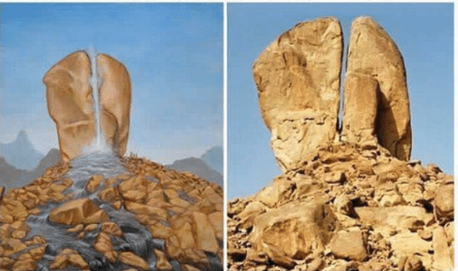
And the Lord said to Moses, “Pass on before the people, taking with you some of the elders of Israel, and take in your hand the staff with which you struck the Nile, and go. Behold, I will stand before you there on the rock at Horeb, and you shall strike the rock, and water shall come out of it, and the people will drink.” And Moses did so, in the sight of the elders of Israel.
Exodus 17:5-6
耶和華對摩西說：你手裡拿著你先前擊打河水的杖，帶領以色列的幾個長老，從百姓面前走過去。我必在何烈的磐石那裡，站在你面前。你要擊打磐石，從磐石裡必有水流出來，使百姓可以喝。摩西就在以色列的長老眼前這樣行了。
出埃及记 17:5-6
Notes:
1st time Rock is mentioned in the bible

Slide 15
Meaning of the rock in the OT
There are 101 verses in the OT containing the word ‘rock’:
2nd place:
And the Lord said, “Behold, there is a place by me where you shall stand on the rock, and while my glory passes by I will put you in a cleft of the rock, and I will cover you with my hand until I have passed by. Then I will take away my hand, and you shall see my back, but my face shall not be seen.”
Exodus 33:21-23
耶和華說：看哪，在我這裡有地方，你要站在磐石上。我的榮耀經過的時候，我必將你放在磐石穴中，用我的手遮掩你，等我過去，然後我要將我的手收回，你就得見我的背，卻不得見我的面。
出埃及记 33:21-23
3rd place:
“Take the staff, and assemble the congregation, you and Aaron your brother, and tell the rock before their eyes to yield its water. So you shall bring water out of the rock for them and give drink to the congregation and their cattle.”
Numbers 20:8
你拿著杖去，和你的哥哥亞倫招聚會眾，在他們眼前吩咐磐石發出水來，水就從磐石流出，給會眾和他們的牲畜喝。
民数记 20:8

Slide 16
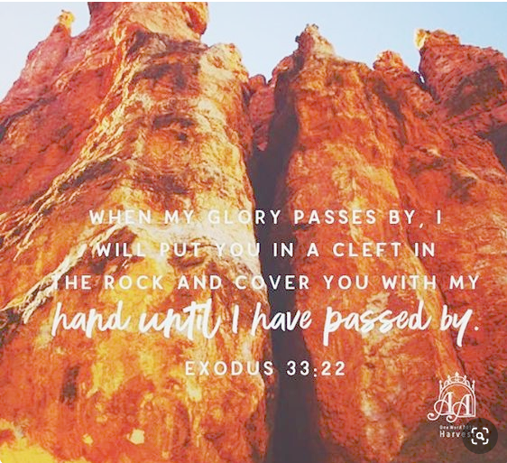
Notes:
What are these rocks?

Slide 17
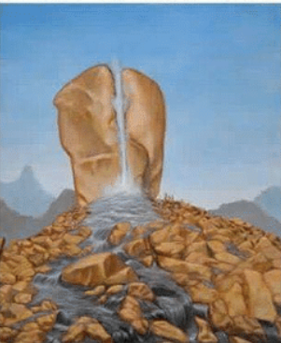
For I do not want you to be unaware, brothers, that our fathers were all under the cloud, and all passed through the sea, and all were baptized into Moses in the cloud and in the sea, and all ate the same spiritual food, and all drank the same spiritual drink. For they drank from the spiritual Rock that followed them, and the Rock was Christ. 1 Corinthians 10:1-4
弟兄們，我不願意你們不曉得，我們的祖宗從前都在雲下，都從海中經過，都在雲裡、海裡受洗歸了摩西；並且都吃了一樣的靈食，也都喝了一樣的靈水。所喝的，是出於隨著他們的靈磐石；那磐石就是基督。 哥林多前書 10:1-4
Notes:
Paul gave the answer in the new testament

Slide 18
As you come to him, a living stone rejected by men but in the sight of God chosen and precious, you yourselves like living stones are being built up as a spiritual house, to be a holy priesthood, to offer spiritual sacrifices acceptable to God through Jesus Christ. For it stands in Scripture:
“Behold, I am laying in Zion a stone,
a cornerstone chosen and precious,
and whoever believes in him will not be put to shame.”
1 Peter 2:4-6
主乃活石，固然是被人所棄的，卻是被神所揀選、所寶貴的。你們來到主面前，也就像活石，被建造成為靈宮，作聖潔的祭司，藉著耶穌基督奉獻神所悅納的靈祭。
因為經上說：看哪，我把所揀選、所寶貴的房角石安放在錫安；信靠他的人必不至於羞愧。
彼得前書 2:4-6
Notes:
Coming back at our verses in Peter, this is a picture, a living stone, this has been prophesied many times in the OT

Slide 19
I thank you that you have answered me
and have become my salvation.
The stone that the builders rejected
has become the cornerstone.
This is the Lord's doing;
it is marvelous in our eyes.
This is the day that the Lord has made;
let us rejoice and be glad in it.
Psalm 118:21-24
我要稱謝你，因為你已經應允我，
又成了我的拯救！
匠人所棄的石頭
已成了房角的頭塊石頭。
這是耶和華所做的，
在我們眼中看為希奇。
這是耶和華所定的日子，
我們在其中要高興歡喜！
诗篇 118:21-24
Notes:
OT place 1

Slide 20
therefore thus says the Lord God,
“Behold, I am the one
who has laid as a foundation in Zion,
a stone, a tested stone,
a precious cornerstone,
of a sure foundation:
‘Whoever believes will not be in haste.’
Isaiah 28:16
所以，主耶和華如此說：
看哪，我在錫安
放一塊石頭作為根基，
是試驗過的石頭，
是穩固根基，
寶貴的房角石；
信靠的人必不著急。
以賽亞書 28:16
Notes:
OT place 2

Slide 21
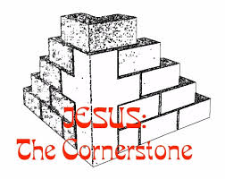
As you come to him, a living stone rejected by men but in the sight of God chosen and precious, you yourselves like living stones are being built up as a spiritual house, to be a holy priesthood, to offer spiritual sacrifices acceptable to God through Jesus Christ. For it stands in Scripture:
“Behold, I am laying in Zion a stone,
a cornerstone chosen and precious,
and whoever believes in him will not be put to shame.”
1 Peter 2:4-6
主乃活石，固然是被人所棄的，卻是被神所揀選、所寶貴的。你們來到主面前，也就像活石，被建造成為靈宮，作聖潔的祭司，藉著耶穌基督奉獻神所悅納的靈祭。
因為經上說：看哪，我把所揀選、所寶貴的房角石安放在錫安；信靠他的人必不至於羞愧。
彼得前書 2:4-6
Notes:
Living stone, rejected by man, but a corner stone

Slide 22
As you come to him, a living stone rejected by men but in the sight of God chosen and precious, you yourselves like living stones are being built up as a spiritual house, to be a holy priesthood, to offer spiritual sacrifices acceptable to God through Jesus Christ. For it stands in Scripture:
“Behold, I am laying in Zion a stone,
a cornerstone chosen and precious,
and whoever believes in him will not be put to shame.”
1 Peter 2:4-6
主乃活石，固然是被人所棄的，卻是被神所揀選、所寶貴的。你們來到主面前，也就像活石，被建造成為靈宮，作聖潔的祭司，藉著耶穌基督奉獻神所悅納的靈祭。
因為經上說：看哪，我把所揀選、所寶貴的房角石安放在錫安；信靠他的人必不至於羞愧。
彼得前書 2:4-6
Notes:
Living stone - are we living stones?

Slide 23
As you come to him, a living stone rejected by men but in the sight of God chosen and precious, you yourselves like living stones are being built up as a spiritual house, to be a holy priesthood, to offer spiritual sacrifices acceptable to God through Jesus Christ. For it stands in Scripture:
“Behold, I am laying in Zion a stone,
a cornerstone chosen and precious,
and whoever believes in him will not be put to shame.”
1 Peter 2:4-6
主乃活石，固然是被人所棄的，卻是被神所揀選、所寶貴的。你們來到主面前，也就像活石，被建造成為靈宮，作聖潔的祭司，藉著耶穌基督奉獻神所悅納的靈祭。
因為經上說：看哪，我把所揀選、所寶貴的房角石安放在錫安；信靠他的人必不至於羞愧。
彼得前書 2:4-6
Notes:
How stones are prepared to be built into the temple, the spiritual house?

Slide 24
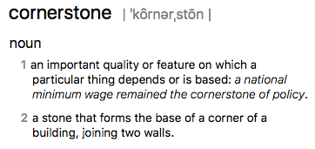
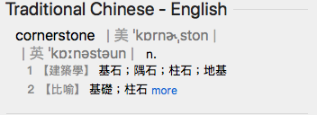
As you come to him, a living stone rejected by men but in the sight of God chosen and precious, you yourselves like living stones are being built up as a spiritual house, to be a holy priesthood, to offer spiritual sacrifices acceptable to God through Jesus Christ. For it stands in Scripture:
“Behold, I am laying in Zion a stone,
a cornerstone chosen and precious,
and whoever believes in him will not be put to shame.”
1 Peter 2:4-6
主乃活石，固然是被人所棄的，卻是被神所揀選、所寶貴的。你們來到主面前，也就像活石，被建造成為靈宮，作聖潔的祭司，藉著耶穌基督奉獻神所悅納的靈祭。
因為經上說：看哪，我把所揀選、所寶貴的房角石安放在錫安；信靠他的人必不至於羞愧。
彼得前書 2:4-6
Notes:
This building work is according to the cornner stone - what is a corner stone

Slide 25
As you come to him, a living stone rejected by men but in the sight of God chosen and precious, you yourselves like living stones are being built up as a spiritual house, to be a holy priesthood, to offer spiritual sacrifices acceptable to God through Jesus Christ. For it stands in Scripture:
“Behold, I am laying in Zion a stone,
a cornerstone chosen and precious,
and whoever believes in him will not be put to shame.”
1 Peter 2:4-6
主乃活石，固然是被人所棄的，卻是被神所揀選、所寶貴的。你們來到主面前，也就像活石，被建造成為靈宮，作聖潔的祭司，藉著耶穌基督奉獻神所悅納的靈祭。
因為經上說：看哪，我把所揀選、所寶貴的房角石安放在錫安；信靠他的人必不至於羞愧。
彼得前書 2:4-6
Notes:
The corner stone is the one all the buildings are measured to, built upon, and even more so, all the buildings are from in one sense.

Slide 27
But you are a chosen race, a royal priesthood, a holy nation, a people for his own possession, that you may proclaim the excellencies of him who called you out of darkness into his marvelous light. Once you were not a people, but now you are God's people; once you had not received mercy, but now you have received mercy.
1 Peter 2:9-10
惟有你們是被揀選的族類，是有君尊的祭司，是聖潔的國度，是屬神的子民，要叫你們宣揚那召你們出黑暗入奇妙光明者的美德。你們從前算不得子民，現在卻作了神的子民；從前未曾蒙憐恤，現在卻蒙了憐恤。
彼得前書 2:9-10

Slide 28
The latter glory of this house shall be greater than the former, says the Lord of hosts. And in this place I will give peace, declares the Lord of hosts. Haggai 2:9
這殿後來的榮耀必大過先前的榮耀；在這地方我必賜平安。
這是萬軍之耶和華說的。 哈該書 2:9

Slide 29
Notes:
Review the background of 1 Peter - transition to the topic of suffering and trials

Slide 30
What is one theme through the process in 1 Peter? 貫穿彼得前書的一個主題
“so as to live for the rest of the time in the flesh no longer for human passions but for the will of God. “
1 Peter 4:2
你們存這樣的心，從今以後就可以不從人的情慾，只從神的旨意在世度餘下的光陰。
彼得前書 4:2
Notes:
Why suffersings? Didn’t the Bible say all things work together for good, Romans 8:28
And we know that for those who love God all things work together ^{*xh}for good,^{*n1} for ^{*xi}those who are called according to his purpose.

Slide 31
He said to them, “But who do you say that I am?” Simon Peter replied, “You are the Christ, the Son of the living God.” And Jesus answered him, “Blessed are you, Simon Bar-Jonah! For flesh and blood has not revealed this to you, but my Father who is in heaven. And I tell you, you are Peter, and on this rock I will build my church, and the gates of hell shall not prevail against it. I will give you the keys of the kingdom of heaven, and whatever you bind on earth shall be bound in heaven, and whatever you loose on earth shall be loosed in heaven.”
…
Then Jesus told his disciples, “If anyone would come after me, let him deny himself and take up his cross and follow me. For whoever would save his life will lose it, but whoever loses his life for my sake will find it.
Matt 16:15-19, 24-25
耶穌說：你們說我是誰？西門彼得回答說：你是基督，是永生神的兒子。耶穌對他說：西門巴約拿，你是有福的！因為這不是屬血肉的指示你的，乃是我在天上的父指示的。我還告訴你，你是彼得，我要把我的教會建造在這磐石上；陰間的權柄（權柄：原文是門），不能勝過他。我要把天國的鑰匙給你，凡你在地上所捆綁的，在天上也要捆綁；凡你在地上所釋放的，在天上也要釋放。
...
于是，耶稣对门徒说：“若有人要跟从我，就当舍己，背起他的十字架来跟从我。因为凡要救自己生命的，必丧掉生命；凡为我丧掉生命的，必得着生命。
馬太福音16:15-19, 24-25
Notes:
There is a kingdom conflict, we are sojourners, our home is not here
This is something that should be settled in our mind.

Slide 32
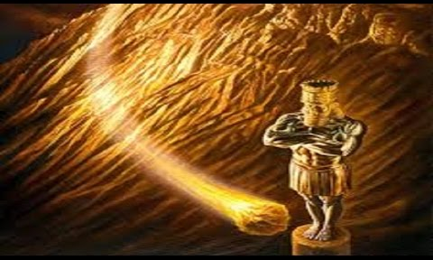
你觀看，見有一塊非人手鑿出來的石頭打在這像半鐵半泥的腳上，把腳砸碎；於是金、銀、銅、鐵、泥都一同砸得粉碎，成如夏天禾場上的糠秕，被風吹散，無處可尋。打碎這像的石頭變成一座大山，充滿天下。
…
當那列王在位的時候，天上的神必另立一國，永不敗壞，也不歸別國的人，卻要打碎滅絕那一切國，這國必存到永遠。
但以理書 2:34-35, 44
As you looked, a stone was cut out by no human hand, and it struck the image on its feet of iron and clay, and broke them in pieces. Then the iron, the clay, the bronze, the silver, and the gold, all together were broken in pieces, and became like the chaff of the summer threshing floors; and the wind carried them away, so that not a trace of them could be found. But the stone that struck the image became a great mountain and filled the whole earth.
...
And in the days of those kings the God of heaven will set up a kingdom that shall never be destroyed, nor shall the kingdom be left to another people. It shall break in pieces all these kingdoms and bring them to an end, and it shall stand forever,
Daniel 2:34-35, 44
Notes:
The stone brings the kingdom of heaven - the eternal kingdom, the mountain filled the whole earth

Slide 33
He said to them, “But who do you say that I am?” Simon Peter replied, “You are the Christ, the Son of the living God.” And Jesus answered him, “Blessed are you, Simon Bar-Jonah! For flesh and blood has not revealed this to you, but my Father who is in heaven. And I tell you, you are Peter, and on this rock I will build my church, and the gates of hell shall not prevail against it. I will give you the keys of the kingdom of heaven, and whatever you bind on earth shall be bound in heaven, and whatever you loose on earth shall be loosed in heaven.”
…
Then Jesus told his disciples, “If anyone would come after me, let him deny himself and take up his cross and follow me. For whoever would save his life will lose it, but whoever loses his life for my sake will find it.
Matt 16:15-19, 24-25
耶穌說：你們說我是誰？16西門彼得回答說：你是基督，是永生神的兒子。耶穌對他說：西門巴約拿，你是有福的！因為這不是屬血肉的指示你的，乃是我在天上的父指示的。我還告訴你，你是彼得，我要把我的教會建造在這磐石上；陰間的權柄（權柄：原文是門），不能勝過他。我要把天國的鑰匙給你，凡你在地上所捆綁的，在天上也要捆綁；凡你在地上所釋放的，在天上也要釋放。
…
于是，耶稣对门徒说：“若有人要跟从我，就当舍己，背起他的十字架来跟从我。25 因为凡要救自己生命*的，必丧掉生命；凡为我丧掉生命的，必得着生命。
馬太福音16:15-19, 24-25
Notes:
There is another side of suffering - the salvataion of our souls
Naturally we love our soul, our flesh love this world - the lust of the eye, the lust of the flesh, the price of this life
These are to be dealt with in our experiences, these are already crucified with our old man in Christ on the cross

Slide 34
Since therefore Christ suffered in the flesh, arm yourselves with the same way of thinking, for whoever has suffered in the flesh has ceased from sin, so as to live for the rest of the time in the flesh no longer for human passions but for the will of God.
...
And after you have suffered a little while, the God of all grace, who has called you to his eternal glory in Christ, will himself restore, confirm, strengthen, and establish you.
1 Peter 4:1-2, 5:10
基督既在肉身受苦，你們也當將這樣的心志作為兵器，因為在肉身受過苦的，就已經與罪斷絕了。你們存這樣的心，從今以後就可以不從人的情慾，只從神的旨意在世度餘下的光陰。
...
那賜諸般恩典的神曾在基督裡召你們，得享他永遠的榮耀，等你們暫受苦難之後，必要親自成全你們，堅固你們，賜力量給你們。
彼得前書 4:1-2, 5:10
Notes:
14 For the love of Christ controls us, because we have concluded this: that one has died for all, therefore all have died; 15 and he died for all, that those who live might no longer live for themselves but for him who for their sake died and was raised.

Slide 35
What is one theme through the process in 1 Peter? 貫穿彼得前書的一個主題
“so as to live for the rest of the time in the flesh no longer for human passions but for the will of God. “
1 Peter 4:2
你們存這樣的心，從今以後就可以不從人的情慾，只從神的旨意在世度餘下的光陰。
彼得前書 4:2

Slide 36
But you are a chosen race, a royal priesthood, a holy nation, a people for his own possession, that you may proclaim the excellencies of him who called you out of darkness into his marvelous light. Once you were not a people, but now you are God's people; once you had not received mercy, but now you have received mercy.
1 Peter 2:9-10
惟有你們是被揀選的族類，是有君尊的祭司，是聖潔的國度，是屬神的子民，要叫你們宣揚那召你們出黑暗入奇妙光明者的美德。你們從前算不得子民，現在卻作了神的子民；從前未曾蒙憐恤，現在卻蒙了憐恤。
彼得前書 2:9-10

Slide 37
until we all attain to the unity of the faith and of the knowledge of the Son of God, to mature manhood, to the measure of the stature of the fullness of Christ,
so that we may no longer be children, tossed to and fro by the waves and carried about by every wind of doctrine, by human cunning, by craftiness in deceitful schemes.
Rather, speaking the truth in love, we are to grow up in every way into him who is the head, into Christ, from whom the whole body, joined and held together by every joint with which it is equipped, when each part is working properly, makes the body grow so that it builds itself up in love.
Ephesians 4:13-16
直等到我們眾人在真道上同歸於一，認識神的兒子，得以長大成人，滿有基督長成的身量，
使我們不再作小孩子，中了人的詭計和欺騙的法術，被一切異教之風搖動，飄來飄去，就隨從各樣的異端；
惟用愛心說誠實話，凡事長進，連於元首基督，全身都靠他聯絡得合式，百節各按各職，照著各體的功用彼此相助，便叫身體漸漸增長，在愛中建立自己。
以弗所書 4:13-16

Slide 38
Above all, keep loving one another earnestly, since love covers a multitude of sins.
1 Peter 4:8
最要緊的是彼此切實相愛，因為愛能遮掩許多的罪。
彼得前書 4:8

